Slide 1

VGP320 - Database Programming
Gustavo Fernandes

Slide 2
Session 6
Session 6
Code + DB
MongoDB
MySQL

Slide 3
Code + DB
Overview
So far:
Relational databases theory
Relational databases in practice (MySQL)
Non-Relational databases theory
Non-Relational databases in practice (MongoDB)
Good, but in real world we use code to connect to DB

Slide 4
Code + DB
Overview
Connecting to databases is not simple
Establish network connection
Authenticate
Send / Receive commands (most likely SQL queries)
Handle errors/exceptions
Terminate connections
We connect a printer to a computer by using a printer driver
Same with databases
A database driver enables a database connection in other systems by implementing a series of protocols and interfaces

Slide 5
Code + DB
Games -> DB
When developing games, usually we make use of engines
Unity
One of the most popular game engines
Written in C++
Expose commands in different API's, including C#
We would need to set our Unity project to make use of database drivers

Slide 6
Code + DB
C#/.NET examples
Although it is possible to connect directly from Unity-based code, it is not a good practice
Unity is generally used for building end-user application
Exposing classes and connection info: Not safe and not modular
Database code should be managed by backend code
Separation of concerns
Isolating fronted code from backend code
We gain flexibility and improve both stability and security of our game
This is valid for all application, not only games

Slide 7



Code + DB
Unity -> DB
Unity -> Backend -> DB
<code>backend</code>

Slide 8


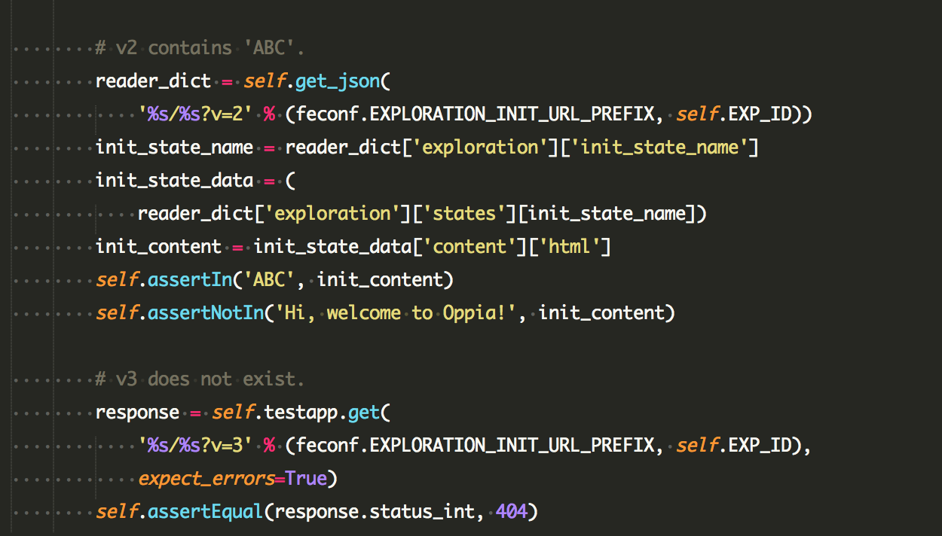

Code + DB
Unity -> DB
Unity -> Backend -> DB

Slide 9
Code + DB
Games -> DB
Let's create our backend code to communicate with the database
Unity can then make use of UnityWebRequest class
UnityWebRequests handle the flow of HTTP communication with web servers.
Other objects - specifically DownloadHandler and UploadHandler - govern downloading and uploading data, respectively.
A set of static functions are provided for convenience; these return UnityWebReques objects properly configured for many common use cases
More on UnityWebRequest documentation
Technically we can use any language to implement the backend!
Freedom!
Since Unity is mostly developed with C#, let's use it to keep consistency

Slide 10
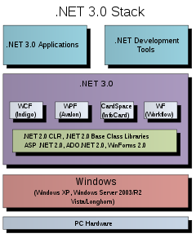
Code + DB
C#/.NET examples
C#/.NET platform makes use of ADO.NET
ADO.NET
Data access technology from the Microsoft .NET Framework that provides communication between relational and non-relational systems
In the following examples we'll make use of MySQL Connector/NET
It implements the required ADO.NET interfaces
Connector/NET is a fully managed ADO.NET data provider written in 100% pure C#

Slide 11
Code + DB
C#/.NET - Hello World
Open MySQL workbench and import the database world from MySQL examples
https://downloads.mysql.com/docs/world.sql.zip
Download the file and extract to your Desktop
Open mysql console
Windows -> cmd -> mysql, OR
MySQL Workbench -> Tools -> "Start Shell..."
Run (change the path to your own path)
SOURCE C:\Users\Administrator\Desktop\world.sql

Slide 12
Code + DB
C#/.NET - Hello World
Confirm data is imported:
use world;
show tables;
SELECT COUNT(*) FROM city; // 4079
SELECT COUNT(*) FROM country; // 239
select count(*) from countrylanguage; // 984
The data set is available as a set of three tables:
country: Information about countries of the world.
city: Information about some of the cities in those countries.
countrylanguage: Languages spoken in each country.

Slide 13
Code + DB
C#/.NET - Hello World
Setup
Install Visual Studio Code.
Install the .NET Core SDK.
Install the C# extension for Visual Studio Code. For more information about how to install extensions on Visual Studio Code, see VS Code Extension Marketplace.
Follow example from
https://docs.microsoft.com/en-us/dotnet/core/tutorials/with-visual-studio-code
Make sure your "Hello World" example works before proceeding
The following examples were copied/based from:
https://dev.mysql.com/doc/connector-net/en/connector-net-tutorials.html

Slide 14
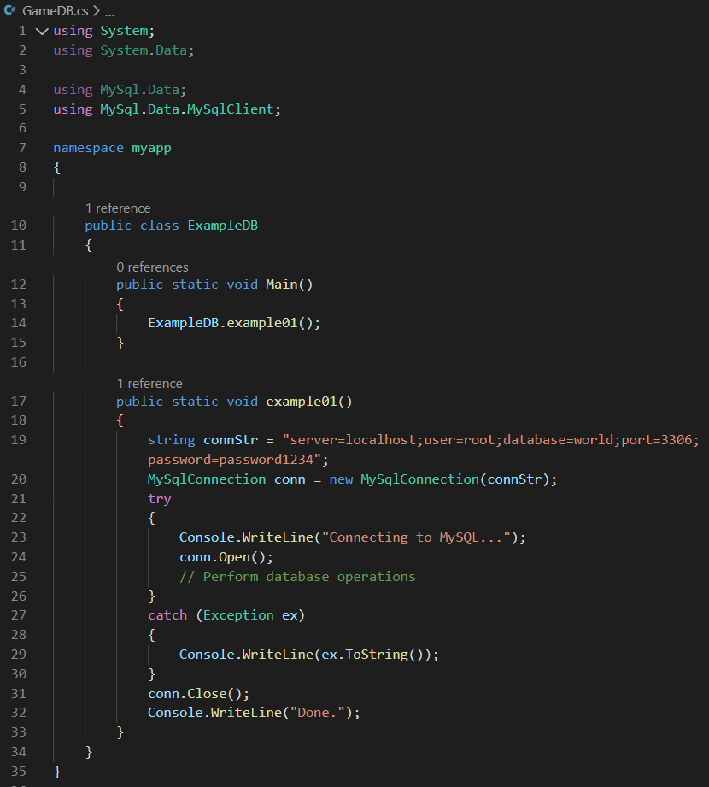
Code + DB
C#/.NET - MySQL Example01
Create a class ExampleDB
Create method example01
You need to change your file *csproj and add the following property:
<StartupObject>
Myapp.ExampleDB
</StartupObject>
Make sure to run
dotnet add package MySql.Data --version 8.0.21

Slide 15
Code + DB
C#/.NET - Connect to MySQL DB
When the MySqlConnection constructor is invoked, it returns a connection object, which is used for subsequent database operations.
Open the connection before any other operations take place.
Before the application exits, close the connection to the database by calling Close on the connection object.
Sometimes an attempt to perform an Open on a connection object can fail, generating an exception that can be handled using standard exception handling code.

Slide 16
Code + DB
C#/.NET - Connect to MySQL DB
When a connection has been established with the MySQL database, the next step is carry out the desired database operations. This can be achieved using the MySqlCommand object.
MySqlCommand provides several methods. 3 important ones:
ExecuteReader to query the database. Results are usually returned in a MySqlDataReader object, created by ExecuteReader.
ExecuteNonQuery to insert, update, and delete data.
ExecuteScalar to return a single value.

Slide 17
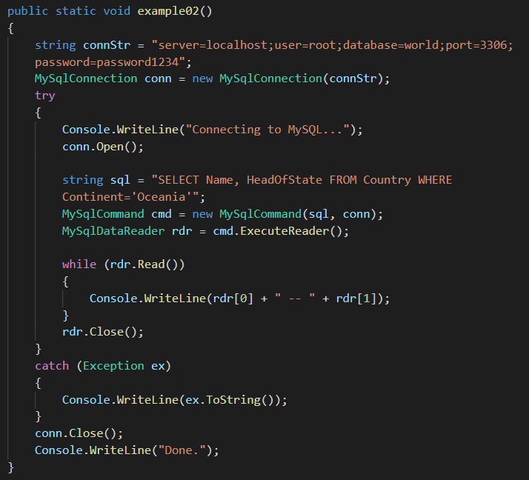
Code + DB
C#/.NET - MySQL Example02
Create a method example02
Change your Main() to run example02

Slide 18
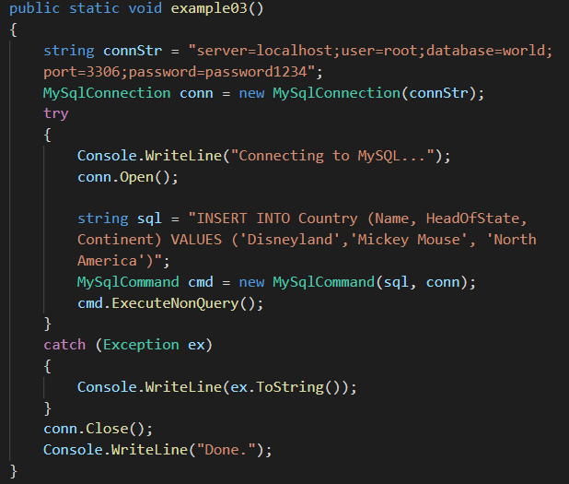
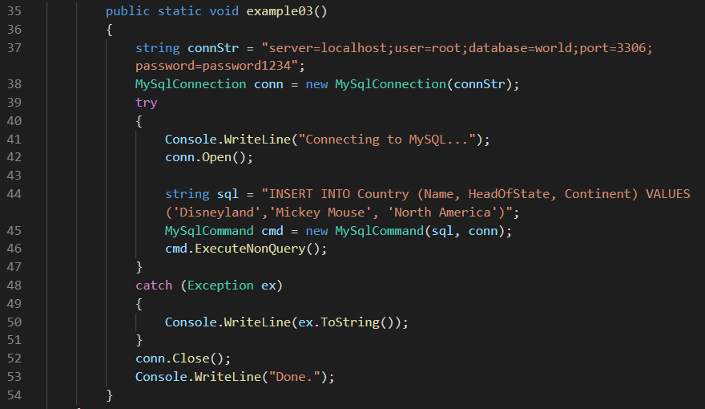
Code + DB
C#/.NET - MySQL Example03
Create a method example03
Change your Main() to run example03
Check total number of countries before and after executing the code

Slide 19
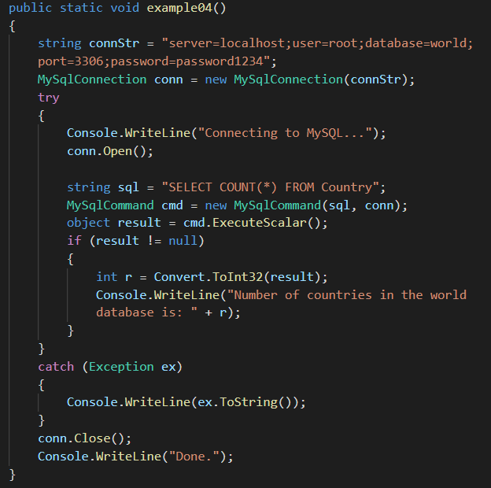
Code + DB
C#/.NET - MySQL Example04
Create a method example04
Change your Main() to run example04

Slide 20
Code + DB
C#/.NET - Connect to MySQL DB
Although it is possible to build SQL query strings directly from user input, this is not advisable as it does not prevent erroneous or malicious information being entered.
It is safer to use parameters as they will be processed as field data only. For example, imagine the following query was constructed from user input:
string sql = "SELECT Name, HeadOfState FROM Country WHERE Continent = "+ continent_name ;
If the string user_continent came from a Text Box control, there would potentially be no control over the string entered by the user. The user could enter a string that generates a runtime error, or in the worst case actually harms the system.

Slide 21
Code + DB
C#/.NET - Connect to MySQL DB
Solution: use parameters
When using parameters it is not possible to do this because a parameter is only ever treated as a field parameter, rather than an arbitrary piece of SQL code.
string sql = "SELECT Name, HeadOfState FROM Country WHERE Continent = @Continent";
cmd.Parameters.AddWithValue("@Continent", "North America");

Slide 22
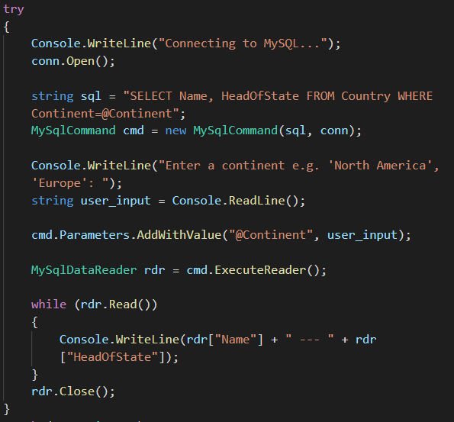
Code + DB
C#/.NET - MySQL Example05
Create a method example05
Change your Main() to run example05
Note that wrapping code was removed to improve readability

Slide 23
Code + DB
C#/.NET - Connect to MySQL DB
Notice how we've been repeating ourselves with the wrapping code
This could be improved by creating a base class SQLWrapper and having other classes extending SQLWrapper
Also, notice how our connection string has hardcoded values
Terrible for code maintenance
Terrible for security (credentials exposed)
Hard run test code in different environments (dev/stage/prod)

Slide 24
Code + DB
C#/.NET - Connect to MySQL DB
Exercise 01 – First to finish it correctly gets 0.5 extra point
Create abstract class SQLWrapper with the following structure
protected MySqlConnection conn; // Stores the connection object
private void openConnection(); // Opens the connection
protected abstract void SQLCommands(); // Children classes will implement their SQLCommands
protected void execute(); // Opens connection, executes SQL sommands, and closes connection
private void closeConnection(); // Closes the connection
Create class MyClass : SQLWrapper
SQLCommands: prints the number of countries where at least 10.0% of population speaks Portuguese
Main: execute the SQL command

Slide 25
Code + DB
C#/.NET - Connect to MySQL DB
Exercise 02 – First to finish it correctly gets 0.5 extra point
Create class SQLWrapperV2
Implement private string readConfig(string key)
Refactor method openConnection() to make use of readConfig(string key)
No database connection should be hardcoded in *cs file
DB Parameters should be available in an external App.config file

Slide 26
BREAK

Slide 27
Code + DB
C#/.NET - Connect to MongoDB
What about connecting with C# to MongoDB?
(Almost the) Same idea as with MySQL
Driver will handle the heavy work
So we do the same steps as with MySQL?
Add driver
Establish connection (optional!)
Execute operations
Close connection

Slide 28
Code + DB
C#/.NET - Connect to MongoDB
Add PackageReference
<PackageReference Include="MongoDB.Bson" Version="2.11.0" />
<PackageReference Include="MongoDB.Driver" Version="2.11.0" />
<PackageReference Include="MongoDB.Driver.Core" Version="2.11.0" />
Add required "using" statements
using MongoDB.Bson;
using MongoDB.Driver;
Start sending commands

Slide 29
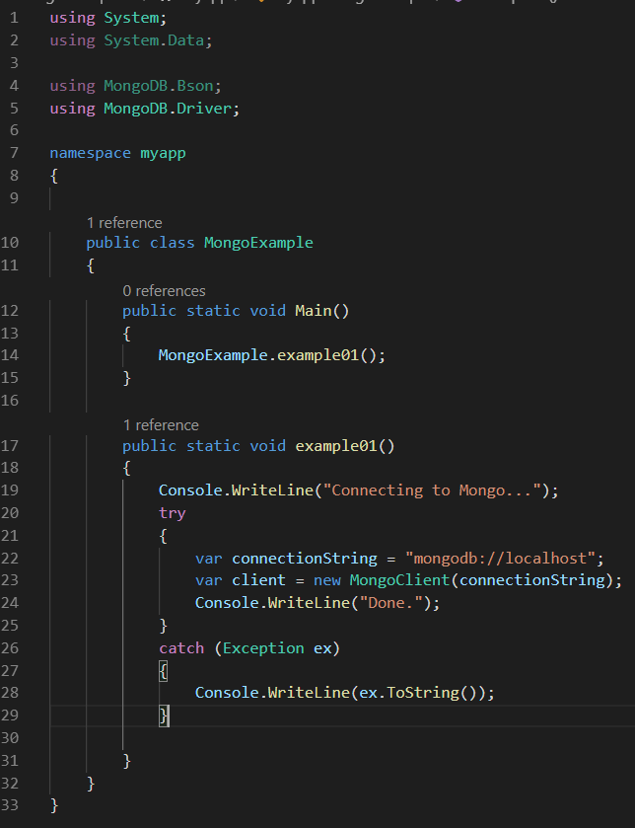
Code + DB
C#/.NET - Mongo Example01
Add the required references
Create a new class MongoExample
Don't forget to update your project config

Slide 30
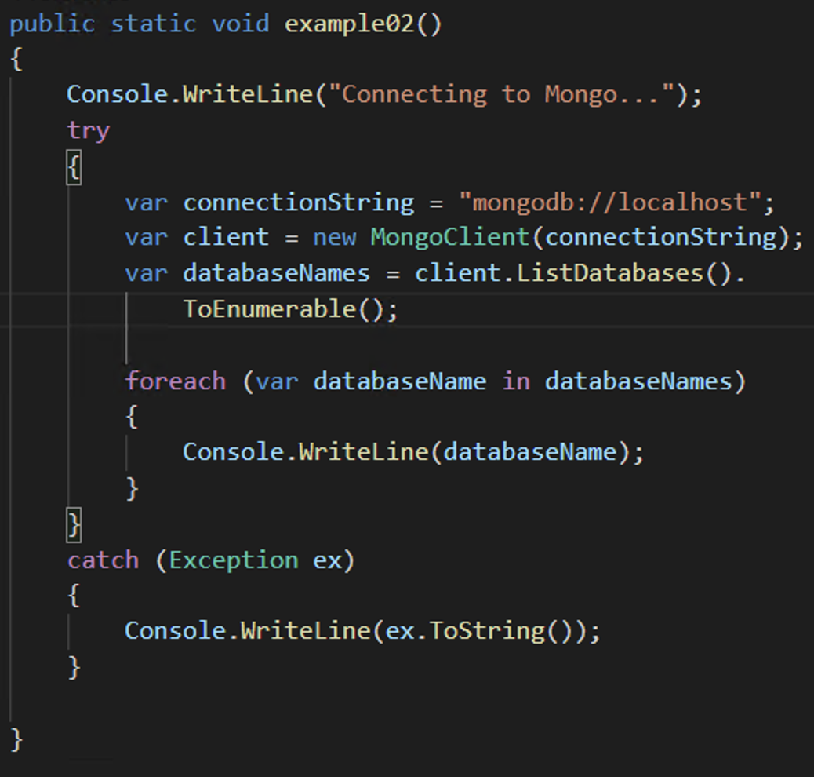
Code + DB
C#/.NET - Mongo Example02
List the existing databases
We can also filter the output by using ["name"]

Slide 31
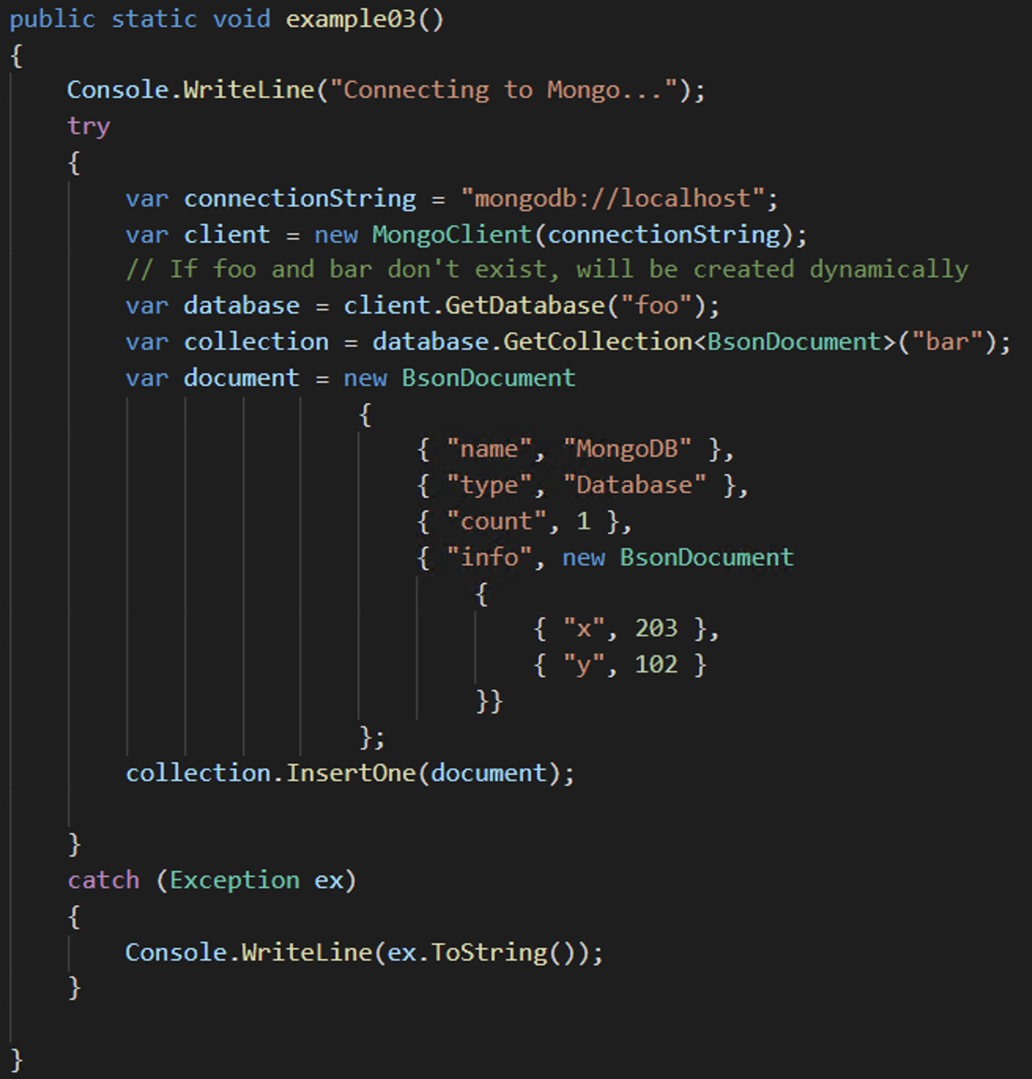
Code + DB
C#/.NET - Mongo Example03
Inserting a document

Slide 32
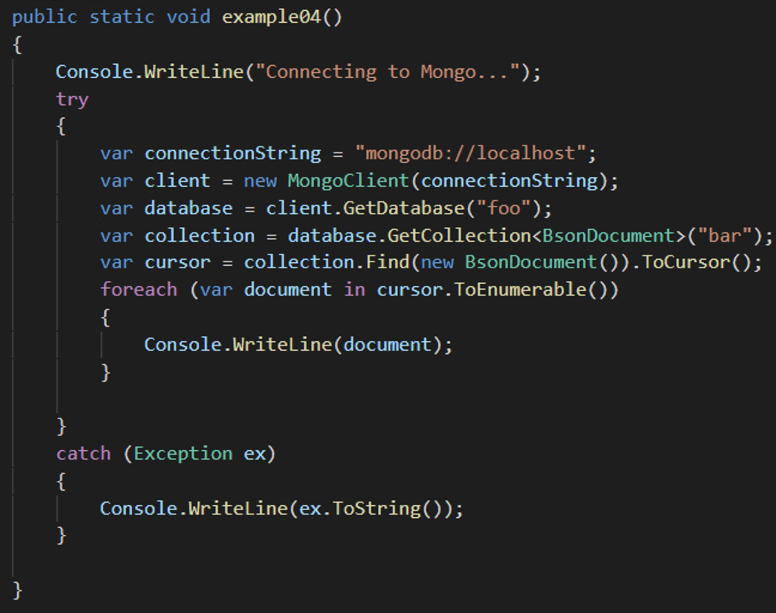
Code + DB
C#/.NET - Mongo
Example04
Retrieving a document

Slide 33
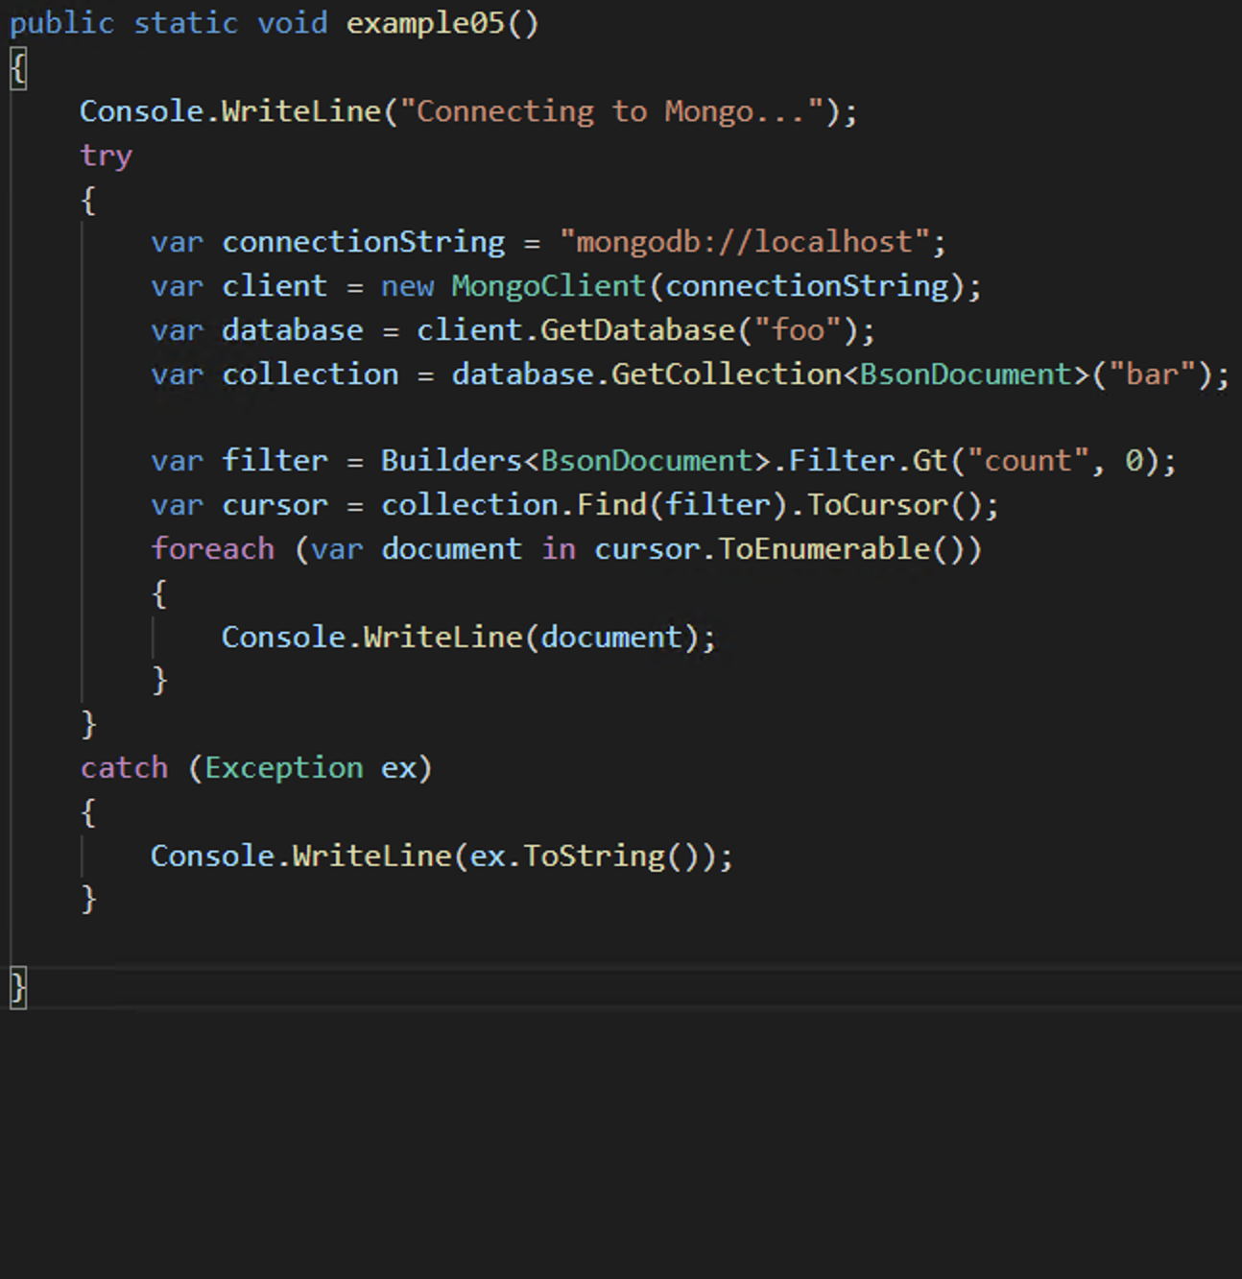
Code + DB
C#/.NET - Mongo
Example05
Retrieving a document
with Filter

Slide 34

Code + DB
C#/.NET - Mongo
Other useful examples
Multiple filters

Slide 35
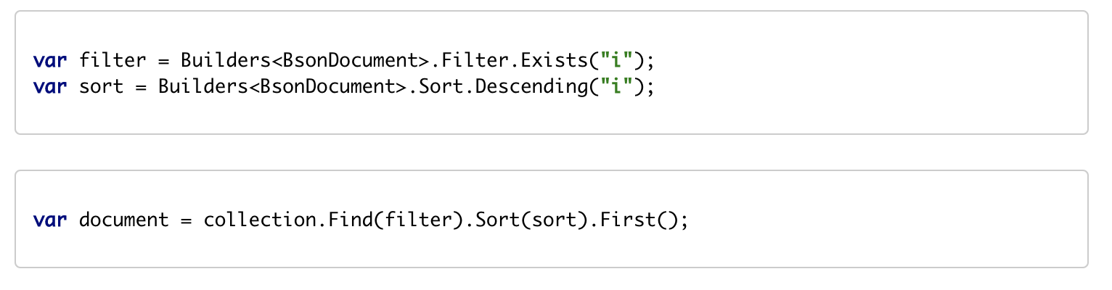
Code + DB
C#/.NET - Mongo
Other useful examples
Sorting

Slide 36
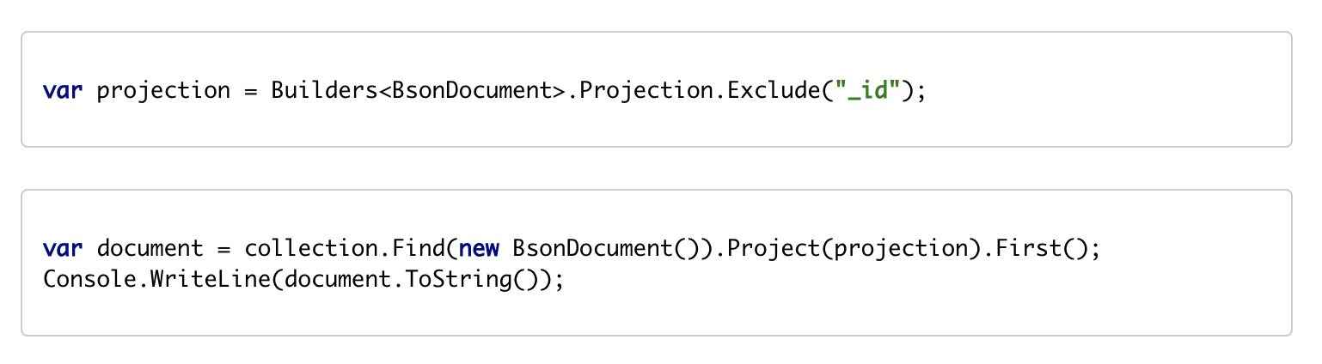
Code + DB
C#/.NET - Mongo
Other useful examples
Projection (selecting fields)

